Slide 1
Representation of Objects - Classification

Slide 2
Recall - Pattern Recognition
Given an input pattern, make a decision about the “category” or “class” of the pattern
Identification of a pattern as a member of a category
Classification (Supervised: known categories)
Clustering (Unsupervised: learning categories)
2
Notes:
2

Slide 3
Approaches
Statistical PR:
Pattern classes represented by statistical measures.
Structural (or Syntactic) PR:
Pattern classes represented by means of formal structures as grammars, automata, strings, etc.
3
Notes:
3

Slide 4

Template Matching
Image is converted into 12x12 bitmap.
4
Notes:
4

Slide 5
Template Matching
Bitmap is represented by 12x12-matrix or by 144-vector with 0 and 1 coordinates.
0 | 0 | 0 | 0 | 0 | 0 | 1 | 1 | 0 | 0 | 0 | 0
0 | 0 | 0 | 0 | 0 | 1 | 1 | 1 | 0 | 0 | 0 | 0
0 | 0 | 0 | 0 | 0 | 1 | 0 | 1 | 1 | 0 | 0 | 0
0 | 0 | 0 | 0 | 1 | 1 | 0 | 1 | 1 | 0 | 0 | 0
0 | 0 | 0 | 0 | 1 | 0 | 0 | 0 | 1 | 0 | 0 | 0
0 | 0 | 0 | 1 | 1 | 0 | 0 | 0 | 1 | 1 | 0 | 0
0 | 0 | 0 | 1 | 1 | 0 | 0 | 0 | 1 | 1 | 0 | 0
0 | 0 | 1 | 1 | 1 | 1 | 1 | 1 | 1 | 1 | 1 | 0
0 | 0 | 1 | 1 | 0 | 0 | 0 | 0 | 0 | 1 | 1 | 0
0 | 1 | 1 | 0 | 0 | 0 | 0 | 0 | 0 | 1 | 1 | 0
0 | 1 | 1 | 0 | 0 | 0 | 0 | 0 | 0 | 0 | 1 | 1
1 | 1 | 0 | 0 | 0 | 0 | 0 | 0 | 0 | 0 | 1 | 1
5
Notes:
5

Slide 6
Template Matching
Training samples – templates with corresponding class:
Template of the image to be recognized:
?
Algorithm:
6
Notes:
6

Slide 7
Template Matching
Number of templates to store:
If fewer templates are stored, some images might not be recognized.
Improvements?
7
Notes:
7

Slide 8
Features
Features are the individual measurable properties of the signal being observed.
The set of features used for pattern recognition is called feature vector.
The number of used features is the dimensionality of the feature vector.
n-dimensional feature vectors can be represented as points in n-dimensional feature space
8
Notes:
8

Slide 9
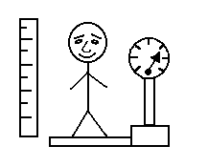
Features
height
weight
Class 1
Class 1
Class 2
Class 2
9
Notes:
9

Slide 10
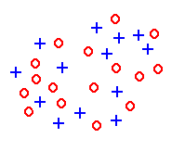
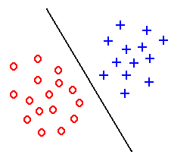
Features
Feature extraction aims to create discriminative features good for classification
Good Features
Objects from the same class have similar feature values.
Objects from different classes have different values.
“Good” features
“Bad” features
10
Notes:
10

Slide 11
Features
Use fewer features if possible
Use features that differentiate classes well
Character recognition example
Good features: aspect ratio, presence of loops
Bad features: number of black pixels, number of connected components
11
Notes:
11

Slide 12
Classifier
Identify the class of a given pattern
12
Notes:
12

Slide 13
Classifier
Distance between Feature Vectors
Instead of finding template exactly matching input template look at how close feature vectors are
Nearest neighbor classification algorithm:
Find template closest to the input pattern.
Classify pattern to the same class as closest template.
Class 1
Class 2
13
Notes:
13

Slide 14
Classifier
K-Nearest Neighbor Classifier
Use k nearest neighbors instead of 1 to classify pattern.
Class 1
Class 2
14
Notes:
14

Slide 15
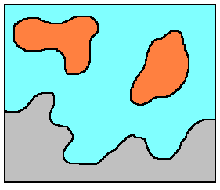
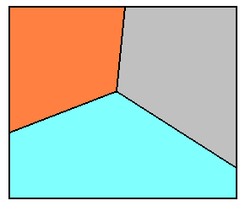
Classifier
A classifier partitions feature space X into class-labeled regions such that:
and
The classification consists of determining to which region a feature vector x belongs to.
Borders between regions are called decision boundaries
15
Notes:
15

Slide 16

Features - Character Images
Suggest some features for the given image

Slide 17
Features - Character Images
Projection Histograms
Count the number of pixels in each column and row of a character image
17
Notes:
17

Slide 18
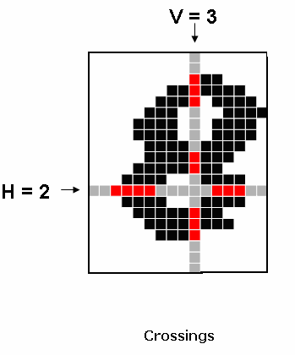
Features - Character Images
Crossings
Count the number of transitions from background to foreground pixels along vertical and horizontal lines through the character image
18
Notes:
18

Slide 19
Features - Character Images
Profiles
The profile counts the number of pixels (distance) between the bounding box of the character image and the edge of the character
19
Notes:
19

Slide 20
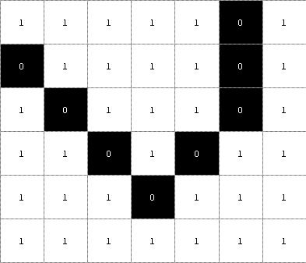

Features - Character Images
Chain Codes
1
3
2
1
3
2
4
8
4
8
5
6
7
5
6
7
6
6
5
5
3
3
3
…
20
Notes:
20

Slide 21
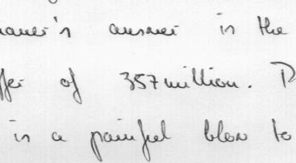
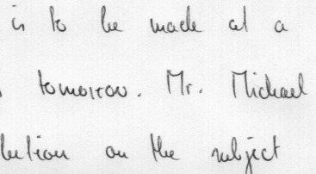
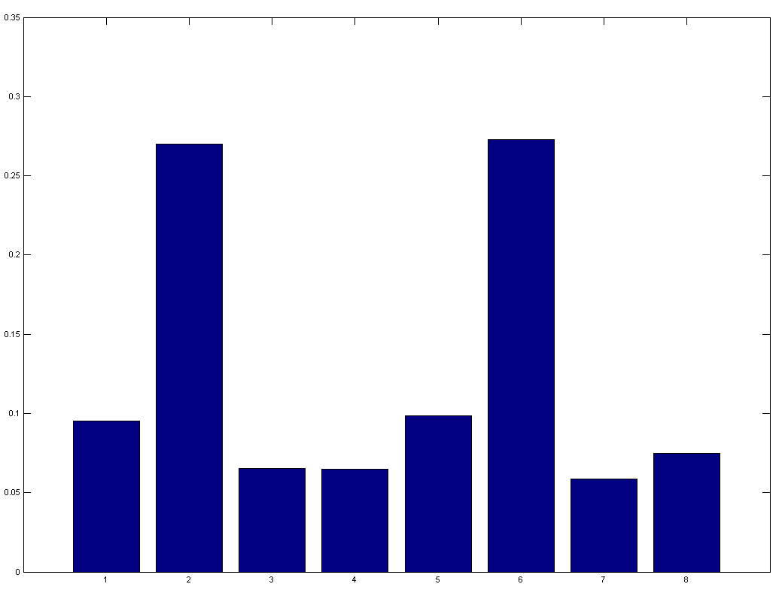
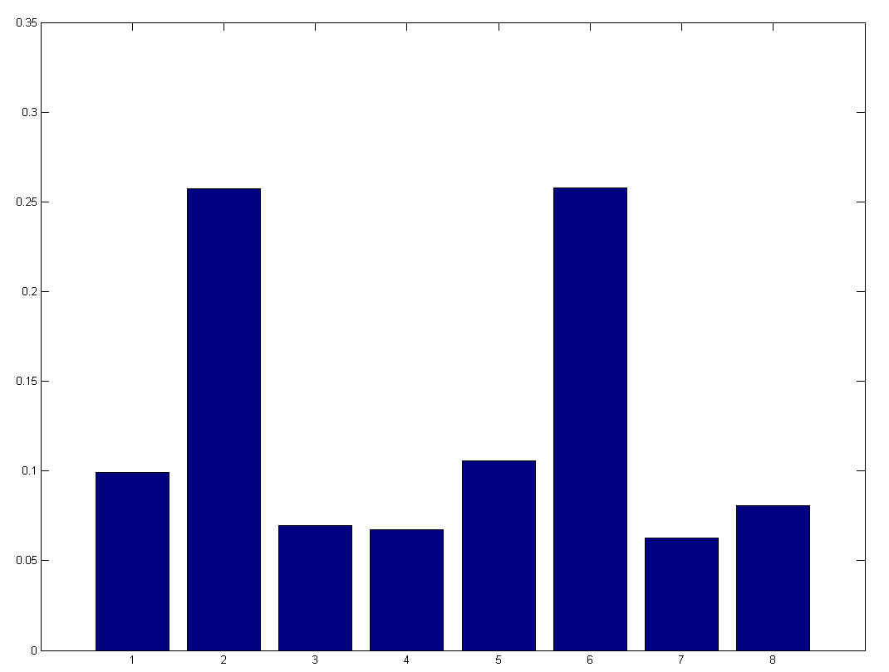
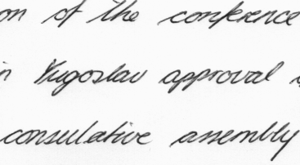
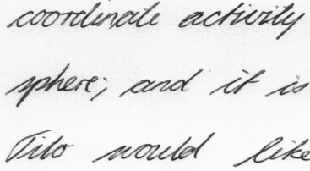
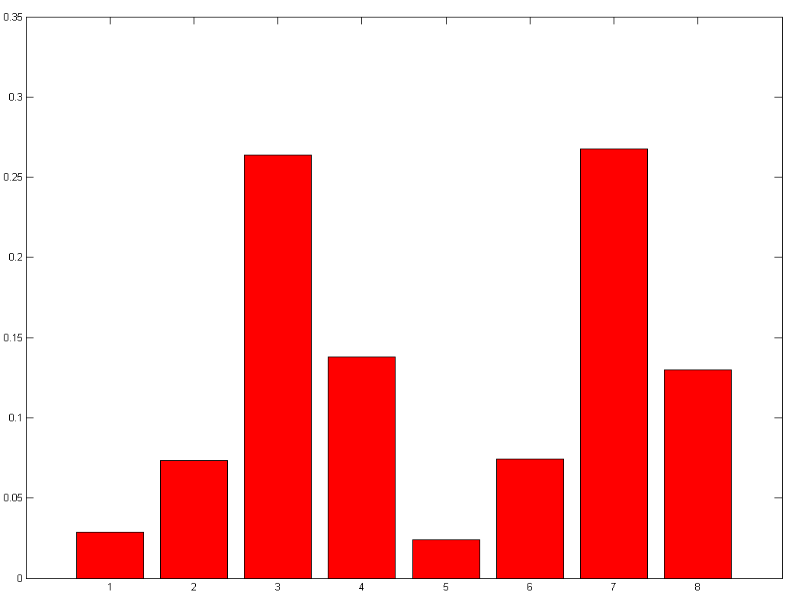
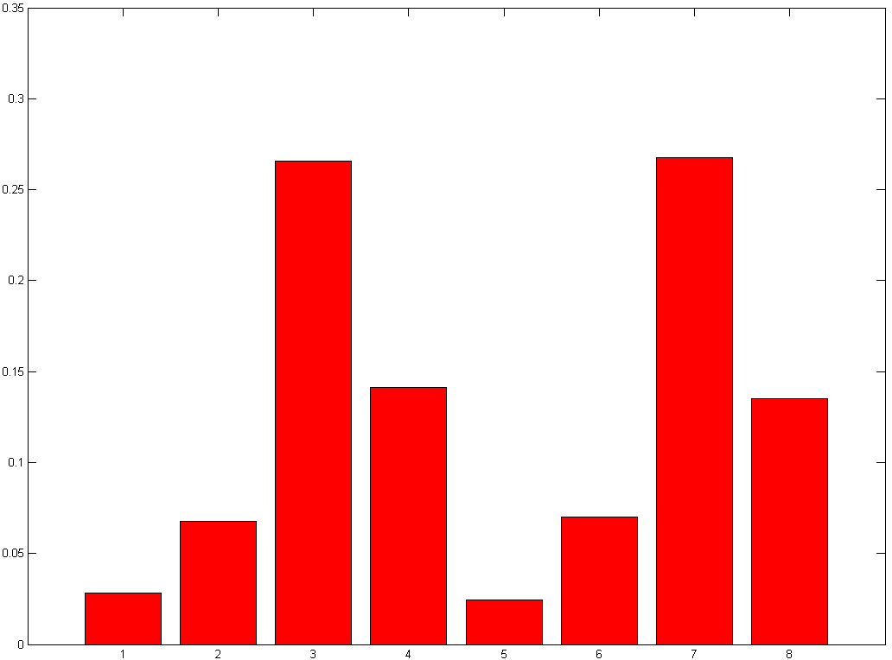
Features - Character Images
Notes:
21

Slide 22
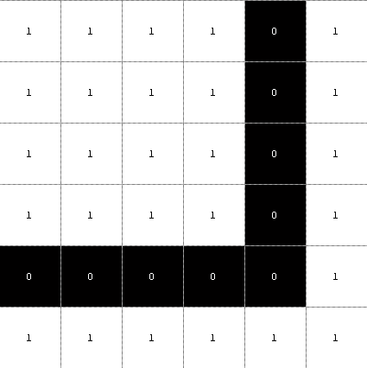
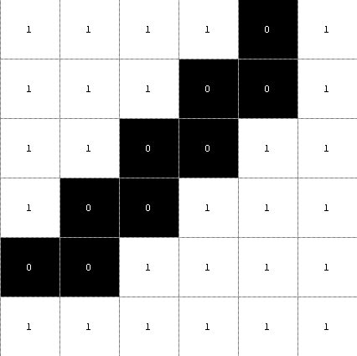
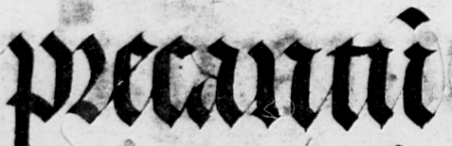
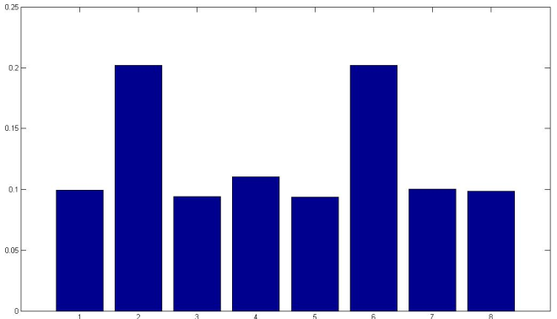
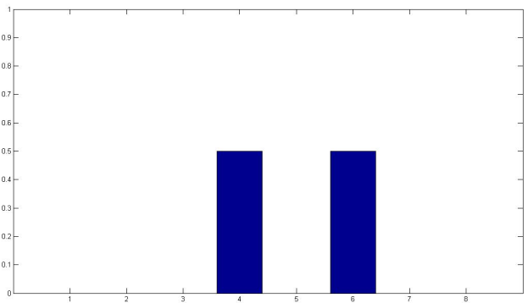
Features - Character Images
Chain Codes - Histogram
6 6 6 6 4 4 4 4
6 4 6 4 6 4 6 4
22
Chain code histogram
Chain code histogram
Notes:
22

Slide 23
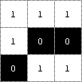
Features - Character Images
Differential Chain Codes
p_{i}
c_{i-1}
p_{i-1}
c_{i}
7
6
θ_{i} =135º
p_{i+1}
(c_{i+1}-c_{i}) mod 8 | 0 | 1 | 2 | 3 | 5 | 6 | 7
θ_{i} | 180° | 135° | 90° | 45° | 315° | 270° | 225°
Chain Code: 6 6 4 5 7 6 …
Differential Chain Code: 0 2 1 2 1 …
23
Notes:
23

Slide 24



Features - Character Images
Polygonization
Polygonized contours

Slide 25
A (Simplified )Recog.System
Two Modes:
Classification Mode
test
pattern
Preprocessing
Feature
Measurement
Classification
Feature
Extraction/
Selection
training
pattern
Preprocessing
Learning
Training Mode
25
Notes:
25

Slide 26
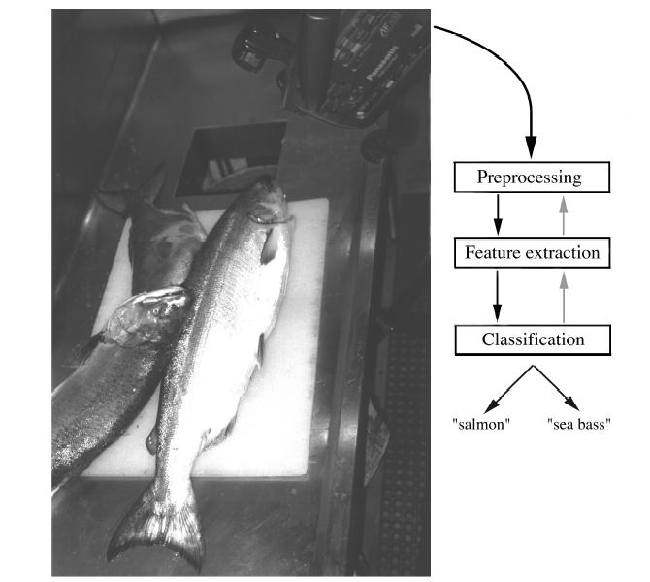
Classification - Example
Sorting incoming Fish on a conveyor according to species using optical sensing
Salmon or Sea Bass?
26
Notes:
26

Slide 27
Classification - Example
Set up a camera and take some sample images to extract features
Length
Lightness
Width
Number and shape of fins
Position of the mouth, etc…
27
Notes:
27

Slide 28
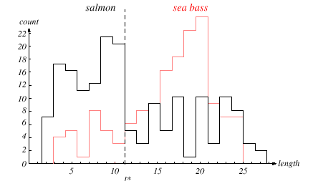
Classification - Example
28
Notes:
28

Slide 29
Classification - Example
The length is a poor feature alone!
Select the lightness as a possible feature.
29
Notes:
29

Slide 30
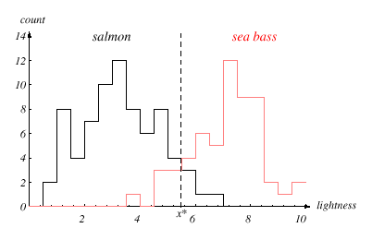
Classification - Example
30
Notes:
30

Slide 31
Classification - Example
x = [x₁, x₂]
FISH
Lightness
Width
31
Notes:
31

Slide 32
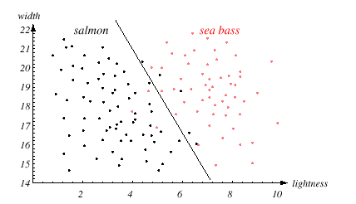
Classification - Example
32
Notes:
32

Slide 33
Classification - Example
We might add other features that are not correlated with the ones we already have. A precaution should be taken not to reduce the performance by adding such “noisy features”
Ideally, the best decision boundary should be the one which provides an optimal performance
33
Notes:
33

Slide 34
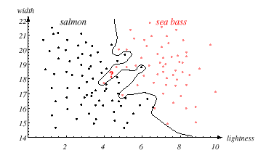
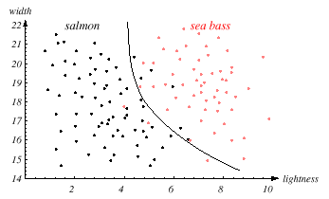
Classification - Example
Generalization?
34
Notes:
34

Slide 35
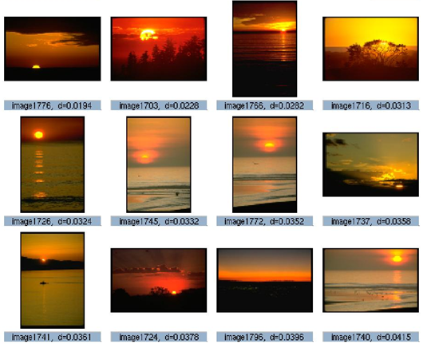

Content Based Image (Video) Retrieval
35
Notes:
35

Slide 36
Content Based Image (Video) Retrieval
CBIR
Image retrieval problem – Searching for images in large datasets
CB – Search analyzes the actual contents of image rather than the metadata (keywords, tags, descriptions)
Given an image with a horse, find all images showing a horse (at least as their main subject).
36
Notes:
36

Slide 37
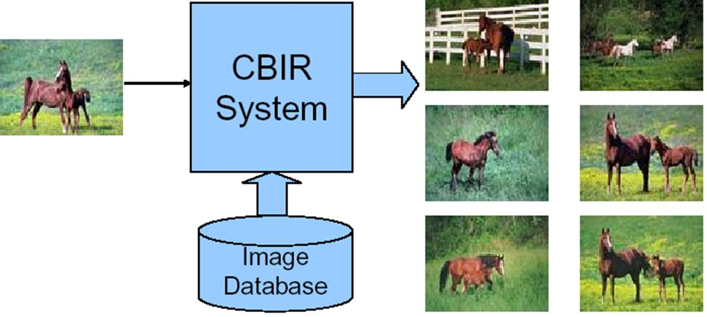
Content Based Image (Video) Retrieval
37
Notes:
37

Slide 38


Content Based Image (Video) Retrieval
CBIR Engines
Name | Image query | Metadata query
Bing
Google
Gazopa
Cires
Fire
38
Notes:
38

Slide 39
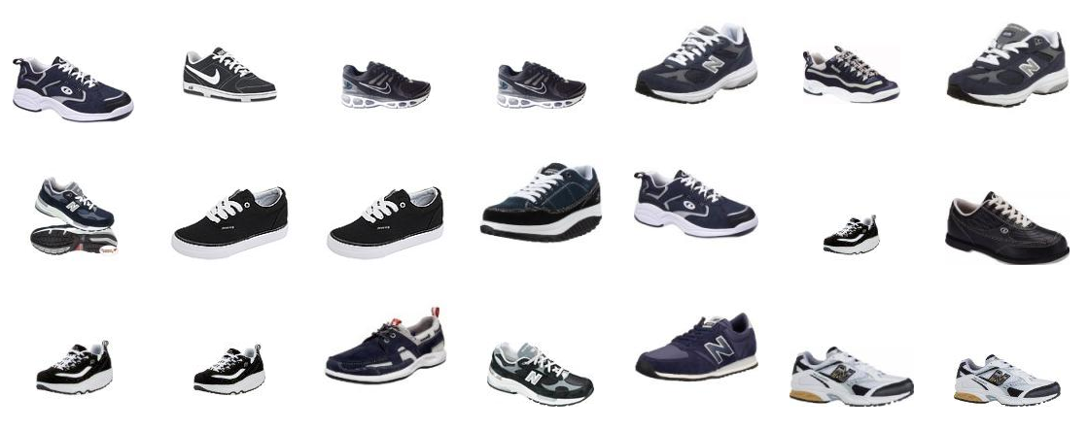
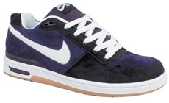
Content Based Image (Video) Retrieval
Gazopa
39
Notes:
39

Slide 40
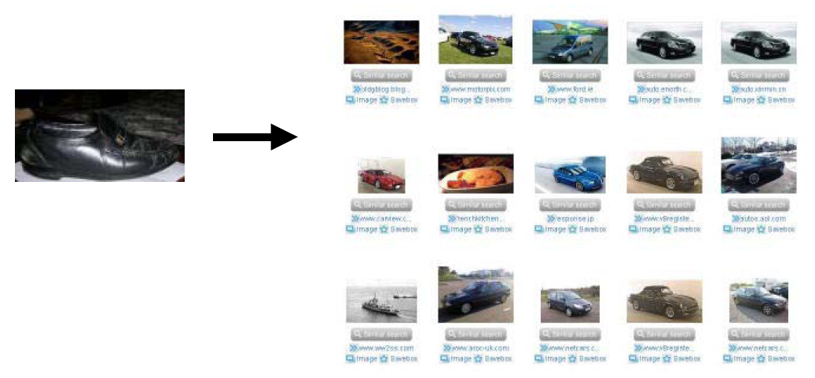
Content Based Image (Video) Retrieval
Gazopa
40
Notes:
40

Slide 41
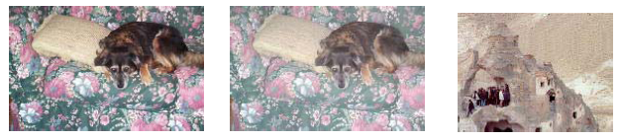
Content Based Image (Video) Retrieval
Challenges
Perceptually close
Computationally close
41
Notes:
41

Slide 42
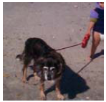
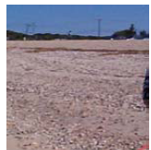
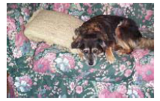
Content Based Image (Video) Retrieval
Challenges
Conceptually close
Computationally close
42
Notes:
42

Slide 43
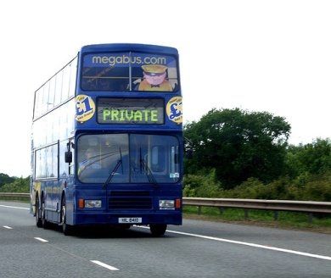

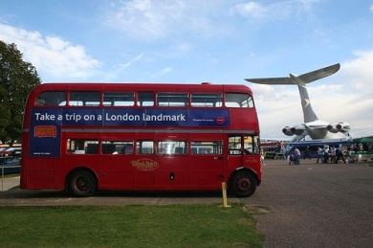
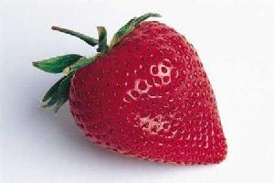
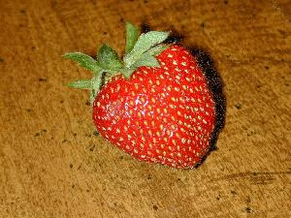
Notion of Similarity

Slide 44
Similarity
But what is similar to you ?
Depends on the application !

Slide 45
















Example
Query Image
Retrieved Images
Image Database
Similarity Assessment
Feature Space

Slide 46
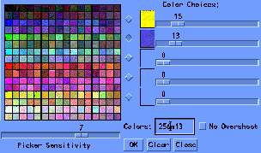
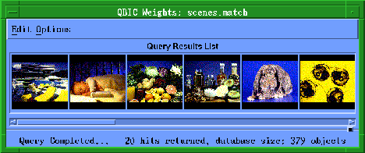
Example - Search by color

Slide 47
Example - Search by texture

Slide 48
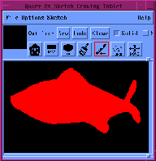
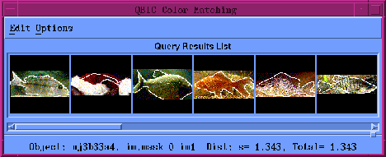
Example - Search by shape

Slide 49
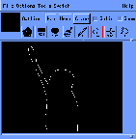
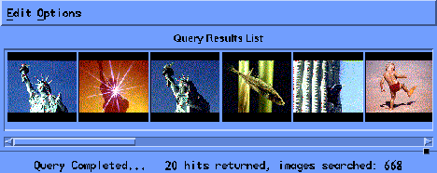
Example - Query by sketch

Slide 50
References
Graphical Models in Document Image Analysis - Venu Govindaraju, CEDAR
Classification of Handwritings in the Perspective of Writer Recognition – PhD Thesis, I. Siddiqi, 2009
Statistical Pattern Recognition: A Review – A.K Jain et al., PAMI (22) 2000
Pattern Recognition and Analysis Course – A.K. Jain, MSU
Introduction to Pattern Recognition -Vojtěch Franc, Czech Technical University in Prague
Pattern Classification” by Duda et al., John Wiley & Sons.
50
Notes:
50

